Slide 1
Healthcare IT Data-Quality Risk-Mitigation
“How to manage healthcare IT risk by standardizing data”
Considering ONC (TEFCA, USCDI, ISA)
FHA FHIM, HL7 (FHIR, CDA, DCM)
OASIS EDXL (CAP, DE-TEP, HAVE)
NIEM IEPD, HSPC (SOLOR, SMART)
HL7 (CIC, PHER, EHR, CIC, CQI, CIMI) Workgroups
Steve Hufnagel, HL7 Facilitator
2018-02-26
Healthcare IT Risk-Management by Standardizing Data: TEFCA-USCDI-FHA-OASIS-HL7-NIEM-HSPC standards, policies, models, methodologies, technologies and model-driven-development tools for federated EDXL-FHIR-CDA-IEPD implementation APIs, guides and components.
See
Notes Pages
Notes:
Bottom Line Up Front (BLUF)
Generic EHR-EDW Requirements: clear, complete, concise, correct and consistent data, which is traceable.
Data entry and billing EHR, legacy data, ancillary systems and partner systems feeding Data analytics EDW
Monthly reports; where, EDW queries/analytics can be optimized for canned data-entry viewing and reporting.
Timely surveillance data-feeds satisfied by a speedy EHR ETL to EDW process, which includes on-the fly data cleansing and bi-directional data entry form to data analytic form mapping, without loss of information.
Point-of-care information, population-based knowledge-analytics and CDS-reasoning.
Emergency-Management Scenario/Use-case Scope: Dual Use worst-case high-value Wounded-Warrior and Natural-Disaster management patient-movement across a Continuum-of-Care Scenario and Healthcare IT use-case; where, Information must move with patients.
New Emergency-Management Requirements: computable-interoperability amongst disparate partners collaborating with an ad-hoc set of heterogeneous systems, during a disaster response patient-movement episode across the continuum-of-care enabled by bi-directional, without loss of information ETL mapping using a SNOMED extension for RxNorm.
Issue: TEFCA-USCDI, HER-EDW Modernizations’ data-quality risk including legacy data and Health Information Exchange (HIE) partners, among Qualified QHINs and the Recognized Coordinating Entity (RCE) relationships.
due-to pre-coordinated data-representations for data entry, viewing, reporting and alerts
Inconsistently mapped-to post-coordinated data-representations for analytics, reasoning and vice-versa,
complicated by different granularities and ontologies within-and-across controlled vocabularies and code sets,
Approach: “fit for use” strategy enabling clinical analytics, reasoning and decision support.
Pre-coordinated data entry for EHR entry and viewing is preferable; where,
Context meta-data collection/analysis/timeliness should be based on the intended use, e.g.,
specific requirements use-cases, e.g., reporting, analytics, reasoning, decision support
specific implementation-specification Detailed Clinical Models (DCMs)
Post-coordinated “canned” EDW analytics, viewing and reporting are preferable; where,
EDW can be optimized for multiple pre-defined use-cases/schemas/queries, considering
Cost/quality of real-time transactional data vs. cost/quality of EDW canned views/reports.
Outcomes measurements.
Post-coordinated point-of care analytics and clinical decision support reasoning within scoped.
real-time ad-hoc post-coordinated transactional analytics and reasoning can be high risk/cost and
must have a use-case with a significant return-on-investment.
Point-of-care real-time lessons learned should influence “canned” EDW analytics over time
Example: pre/post coordinated data-representation forms. (expanded in appendix)
In a pre-coordinated coded clinical entry/viewing form, multiple concepts are brought together in one term. Pre-coordination allows for disambiguation of the relationship of the concepts into one term that might not be possible in post-coordinated systems – entry order is relevant here for example
Clinicians text notes: “closed displaced-fracture on the right leg at the neck of the femur”
ICD-10-CM, EHR data-entry form: displaced-femur fracture type III
In a post-coordinated or normalized data form, concepts are kept broader and separate to be selected and joined with Boolean operators in the process of searching.
An initial post-coordinated representation of the above could be "fracture AND femur AND neck AND displaced AND right leg AND closed" – representation or query order is irrelevant here.
SNOMED CT analytic form: fracture (morphologic abnormality), structure of neck of femur (body structure), right (laterality), plus primary procedure (qualifier value), etc.
Summary: Data quality solutions that are both optimized for clinician data entry, and analytics and reasoning, require ETL to have clinician data-entry bi-directional mapping, without loss of information, to normalized analytic post-coordinated form; where observations have associated-context, which can be multi-faceted, including workflow, provenance and intended use.
Recommendation: EHR Modernizations’ risk mitigation use methodologies, technologies and tools from the FHA-FHIM, VA-SOLOR and HL7 CIC-EHR-CIMI projects being standardized at HL7 and operationalized at HSPC. A focused TEFCA-USCDI tiger team is needed to align the many informatics considerations, technologies, methodologies and tools into a data-quality stewardship and governance process, technology-and-tools methodology empowering efficient and effective 1:1 pre/post coordinated ETL mappings.
Benefit: Positively impact computable interoperability within-and-among Health Information Exchange (HIE) partners, among Qualified QHINs and the Recognized Coordinating Entity (RCE) by sharing the ETL bi-directional, without loss of information, and value sets within SOLOR (SNOMED LOINC, RxNorm) US Realm extension. Improved computable semantic-interoperability empowers better analytics, reasoning, and outcomes measurements and Patient Value (Safety, Quality, Cost).

Slide 2
21st Century Cures Act Data-Quality Strategy Executive Summary: How to manage health IT risk by standardizing data
Data-Quality Risk Mitigation is complicated by the alphabet soup combination of
Policy: TEFCA-USCDI-ISA, NIST Cybersecurity
Technology: FHA (FHIM, SIGG), HL7 (V2, CDA, FHIT, CIMI), OASIS EDXL (CAP DE-TEP, HAVE), HSPC (SOLOR, SMART), NIEM IEPD
Methodology: CIMI DCM Structure-models, HSPC SOLOR meaning-models, NIST cybersecurity models ONC USCDI data-models FHIM Information-models
Organizations: Participant Enterprise Networks, Health information Exchange (HIE) Networks (HINs), TEFCA Qualified HINs (QHINs), TEFCA Recognized Coordinating Entity (RCE)
Healthcare IT Risk-Management by Standardizing Data: TEFCA-USCDI-FHA-OASIS-HL7-NIEM-HSPC standards, policies, models, methodologies, technologies and model-driven-development tools for federated EDXL-FHIR-CDA-IEPD implementation APIs, guides and components.
See
Notes Pages
2
Notes:
This strategy focuses on the Extraction, Transformation and Load (ETL) process from an EHR core “bespoke/proprietary” data model’s bi-directional data mapping, without loss of information, to a normalized analytic post-coordinated form, which can be maintained and governed independent of the operational EHR systems’ deployments. Our scope assumes ONC TEFCA addresses the trust and common use requirements and NIST CSF addresses the security requirements. This ETL focused strategy also applies to legacy data and Health Information Exchange (HIE) data-sharing. If operationalized at a national and ideally international level, the strategy can meet the worst-case, high-value combat-casualty and disaster-management use-cases’ requirement for computable-interoperability amongst disparate partners collaborating within an ad-hoc set of heterogeneous systems, during a wounded-warrior or medically-impacted civilian patient-movement episode across an emergency-management continuum-of-care. The pragmatic dual-use strategy uses ONC-FHA-NIST-OASIS-HL7-NIEM-HSPC standards, policies, methodologies, technologies and model-driven-development tools for federated EDXL-FHIR-CDA-IEPD APIs, and reference implementation (guides, test-fixtures, methodologies, technologies, tools, components, software development kits) using US Core Data for Interoperability and US SNOMED extension for LOINC and RxNorm terminology by Federal Agencies, partners, researchers, venders and contractors.

Slide 3
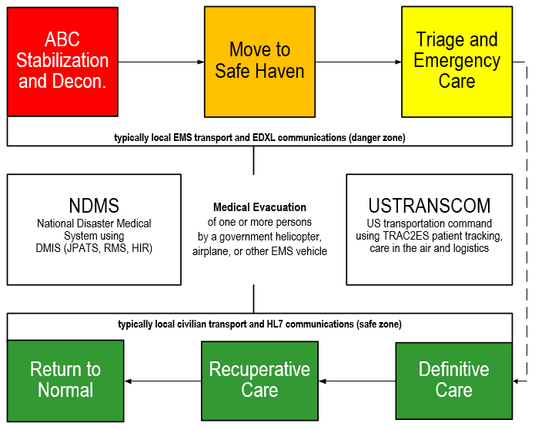
Natural-Disaster Continuum-of-Care Scenario
Where, information must move with patients
Notes:
Requirements: computable-interoperability amongst disparate partners collaborating with an ad-hoc set of heterogeneous systems, during a disaster response patient-movement episode across the continuum-of-care.

Slide 4
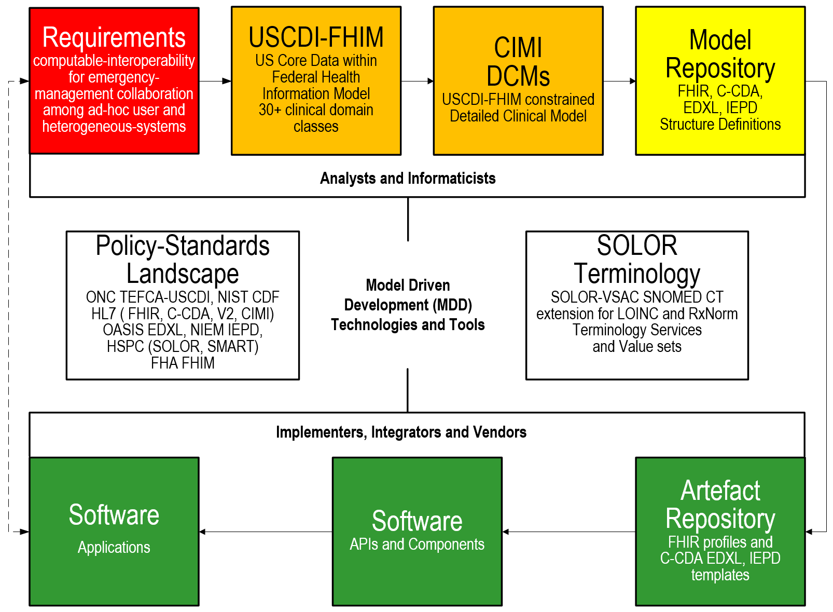
Data-Quality Risk-Mitigation Strategy Model-Driven-Development Methodology
Healthcare IT Risk-Management by Standardizing Data: TEFCA-USCDI-FHA-OASIS-HL7-NIEM-HSPC standards, policies, models, methodologies, technologies and model-driven-development tools for federated EDXL-FHIR-CDA-IEPD implementation APIs, guides and components.
See
Notes Pages
4
Notes:
The benefit of standard USCDI-FHIM-CIMI Principles and Reference Models resulting in Detailed Clinical Models (DCMs) for EDXL, FHIR, CDA and NIEM is an Architectural Framework for computable semantic-interoperability aka interpretability across time, locations, systems and care contexts, assuming the re-usable “stack” is standardized and has widespread implementation. Seamless tools can result in efficiency and effectiveness. This information-model “stack” foundation is mission-essential for
collection, communication, aggregation and interpretation of patient data to accelerate secondary uses in public health, disease surveillance, post-approval monitoring, and patient-centered outcomes research.
health-related services including telecare, clinical decision support, research, and quality measurement, improving healthcare access, quality, and uniformity.
patients, clinicians, and the public to realize major benefits from improved care coordination, reduction of medical errors, and decreased costs resulting in healthier lives.

Slide 5
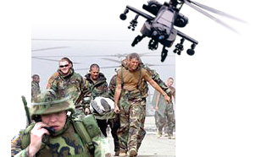
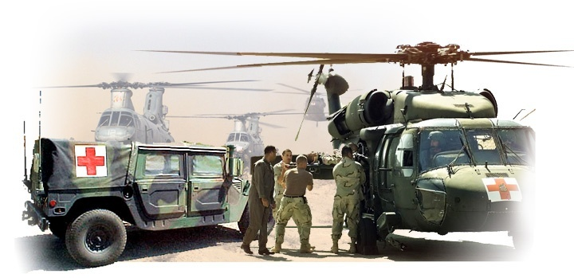
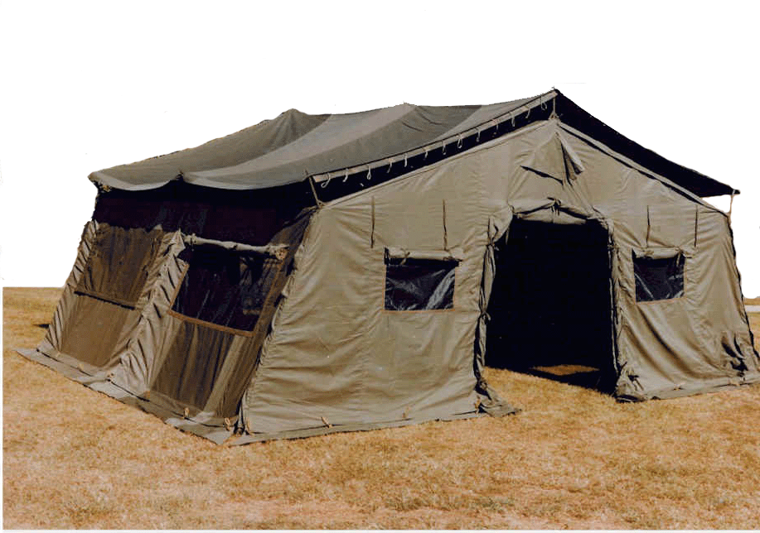



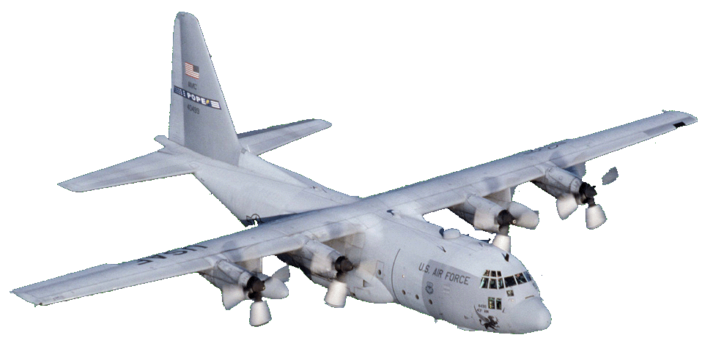


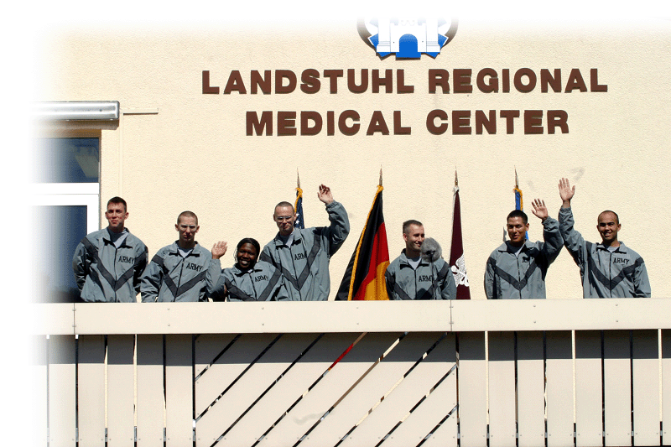
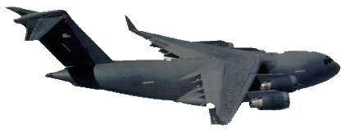

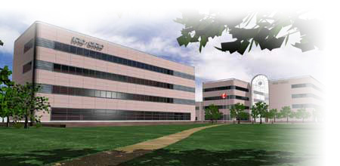

Wounded-Warrior Continuum-of-Care Scenario
Where, information must move with patients
CASEVAC/ MEDEVAC
First Aid
Buddy Care
First Aid/Buddy Care/Aid Station
Role II
Intra-Theater Airlift
Role III
Inter-Theater Airlift
LRMC
Landstuhl Regional
Medical Center
Inter-Theater Airlift
CONUS Medical Facilities
Source: Global Patient Global Movement Trac2es Orientation brief.PPT
Notes:
Requirements: computable-interoperability amongst disparate partners collaborating with an ad-hoc set of heterogeneous systems, during a disaster response patient-movement episode across the continuum-of-care.

Slide 6
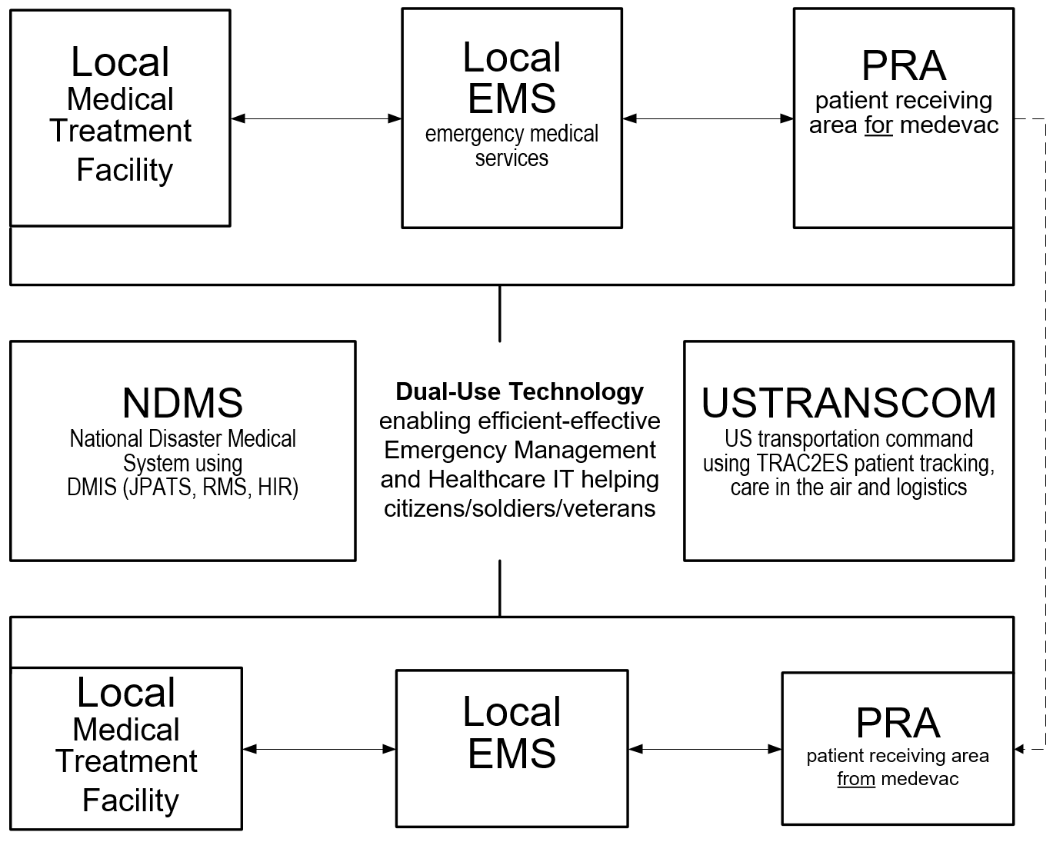
21st Century Cures Act Dual-Use Health IT Worst-Case Highest-Value Disaster-Response Health IT Use-Case
Healthcare IT Risk-Management by Standardizing Data: TEFCA-USCDI-FHA-OASIS-HL7-NIEM-HSPC standards, policies, models, methodologies, technologies and model-driven-development tools for federated EDXL-FHIR-CDA-IEPD implementation APIs, guides and components.
See
Notes Pages
6
Notes:
TEFCA-USCDI-FHIM, OASIS (CAP, DE-TEP, HAVE), HL7 (V2, FHIR, C-CDA),
NIEM IEPD, HSPC (SOLOR, SMART)
Health IT Architecture: light-weight open-source cross-platform APIs and software development kits supporting harmonized USCDI-FHIM-OASIS-HL7-SOLOR data-sharing across federated EDXL,FHIR, C-CDA, NIEM implementations
Fully-qualified USCDI-FHIM-CIMI detailed clinical models (DCMs) are clear, complete, concise, correct and consistent logical requirements-specifications.
SOLOR models-of-meaning enable computable data-information sharing empowering population-analytics and decision-support reasoning.
Smart Healthcare IT and Mobile Apps are efficiently-and-effectively updated by an agile Model-Driven Development (MDD) methodology.
MDD produces quality operational EDXL, FHIR, C-CDA, IEPD APIs, components and test fixtures.

Slide 7
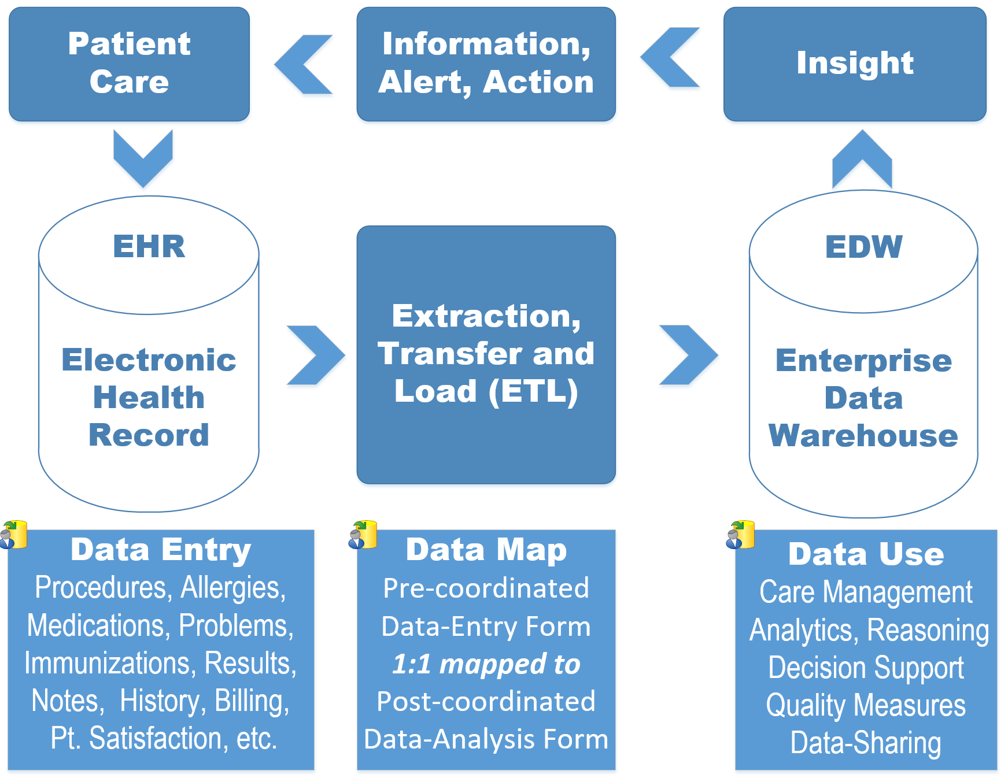
21st Century Cures Act Health IT Value-Cycle Data Quality is the Lynchpin to Patient Value (safety, quality, cost).
Healthcare IT Risk-Management by Standardizing Data: TEFCA-USCDI-FHA-OASIS-HL7-NIEM-HSPC standards, policies, models, methodologies, technologies and model-driven-development tools for federated EDXL-FHIR-CDA-IEPD implementation APIs, guides and components.
See
Notes Pages
7
Notes:
Our IT objective is to make the appropriate data available when it is needed, where it needed and how it is needed. We plan to integrate existing models, with semantically-consistent computable-data, including provenance data (who, what, when, where, why, how) across different platforms, e.g., population health, Clinical Decision support, EHR patient documentation systems, etc. using tooling to generate various implementation styles, including HL7 Fast Healthcare Interoperable Resources (FHIR).
Data quality is the lynchpin to patient value (safety, quality, cost). An Health IT’s objective is to provide secure quality-data services-and-transport across a trusted-continuum of patient-care workflows, enabling computable semantic-interoperability. This empowers a data-information transition to knowledge-wisdom “Learning Health” and “Population-Based Medicine” system APIs, components and services.
Policy: TEFCA-USCDI-ISA, NIST Cybersecurity
Technology: FHA (FHIM, SIGG), HL7 (V2, CDA, FHIT, CIMI), OASIS EDXL (CAP DE-TEP, HAVE), HSPC (SOLOR, SMART), NIEM IEPD
Methodology: CIMI DCM Structure-models, HSPC SOLOR meaning-models, NIST cybersecurity models
ONC USCDI data-models FHIM Information-models
Organizations: Participant Enterprise Networks, Health information Exchange (HIE) Networks (HINs), TEFCA Qualified HINs (QHINs), TEFCA Recognized Coordinating Entity (RCE)

Slide 8

21st Century Cures Act
Data-Quality Problem: Skyscraper Analogy
As-Is
To-Be
Not Harmonized
Not Harmonized
Harmonized
Shared Meaning
No shared terminology model or information model - not interoperable
No shared terminology model, shared information model - not interoperable
Shared terminology model and information model - interoperable future state
*Drawn from Dr. Keith Campbell’s analogy used within The Open Group Healthcare Forum (HCF) article:
Advancing Healthcare Interoperability www.opengroup.org/bookstore/catalog/w16a.htm
Healthcare IT Risk-Management by Standardizing Data: TEFCA-USCDI-FHA-OASIS-HL7-NIEM-HSPC standards, policies, models, methodologies, technologies and model-driven-development tools for federated EDXL-FHIR-CDA-IEPD implementation APIs, guides and components.
See
Notes Pages
8
Notes:
The 50-year data-quality lesson learned, and conundrum is, clinicians prefer pre-coordinated data-entry terminology while analysts prefer post-coordinated normalized controlled terminology forms. Inconsistent pre-post coordinated data mapping is an inherent data quality risk. Mapping is complicated by different granularities and ontologies across and within standards. EHR, EDW, legacy data and HIE exchanges are subject to this data-quality conundrum
BLUF (Bottom Line Up Front)
As is: no shared terminology content (floor 1), no shared information models (floor 2), then they are building from the 3rd floor up. No shared value from the 3rd floor up.
Future State: shared terminology content (floor 1), shared information models (floor 2), sharable value built on floors above.
In a perfect world the following would be done concurrently and with close collaboration
Recommended Solution Part 1: We integrate SOLOR into FHIM
Concurrently, resolving SOLAR gaps
Recommended Solution Part 2: We integrate CIMI, FHIM and CQF
Recommended Solution Part 3: We follow Agile refinement cycles through pilots and implementations
Recommended Solution Part : We develop adequate documentation, test cases, fixtures and supporting resources
In the real world, we are asking:
the Federal Partners to provide resources to make efficient and effective progress in the near, mid and long term.
the Federal Partners to work together to deliver—in an ongoing way—a single integrated terminology system (SOLOR), that meets all US regulatory requirements, while simplifying implementation for developers.
the FHA to facilitate Federal Partner governance and configuration management of this work
This ONC OTS to endorse this initiative and facility resources
We are asking the IPO to provide coordination and facilitation
We are asking HL7 to facilitate
international, commercial and academic peer review and
ballot governance and configuration management.
Coordination of an ISO ballot (this will be several years from now)
Analogy of the Challenge: Today’s efforts occur as if we’re always trying to build the ultimate skyscraper, starting on the 3rd Floor.
Inconsistencies exist/become extended producing transformational (mapping) efforts = models, models everywhere
The problem is that today’s healthcare systems do not capture information and its context consistently, and consequently, they cannot easily share-or-merge information from different sources to create a computable operational-picture (aka longitudinal patient-records, care plans, clinical knowledge and other shared healthcare information across time, multiple care locations and differing contexts).
If continued and unchecked, even the best of implementation accelerators, like FHIR with its extensions and profiles, allow far too much implementation variation; where, each project often creates, from scratch, yet, another information model, e.g. through a mapping exercise.
The missed opportunity is to leverage a shared logical Reference Information Model minimizing the duplicative-work, avoiding inconsistencies and avoiding the necessity to engage these SMEs, these resources and our larger community. This is the “models, models everywhere phenomenon ”. As an example,
Standards, in general, use different formats and rules for ‘simple’ things like: name, address, dates. Resulting in EHR-systems that after decades cannot uniformly exchange this ‘simple’ ubiquitous data; let alone ‘complex’ clinical health data.
the HL7 EHR Interoperability workgroup, in its analysis “Record Entry Lifecycle Event Metadata using FHIR,” found substantial provenance (who, what, when, where and how) inconsistencies among FHIR resources .
http://wiki.hl7.org/index.php?title=EHR_Interoperability_WG
The SOLOR/LEGO team found FHIR tries to define things such as attributes for anatomy, that are not based on a particular model of anatomy, and thus you get semantic overlap, with the burden of reconciliation, which may not even be possible, if left to the end user.

Slide 9
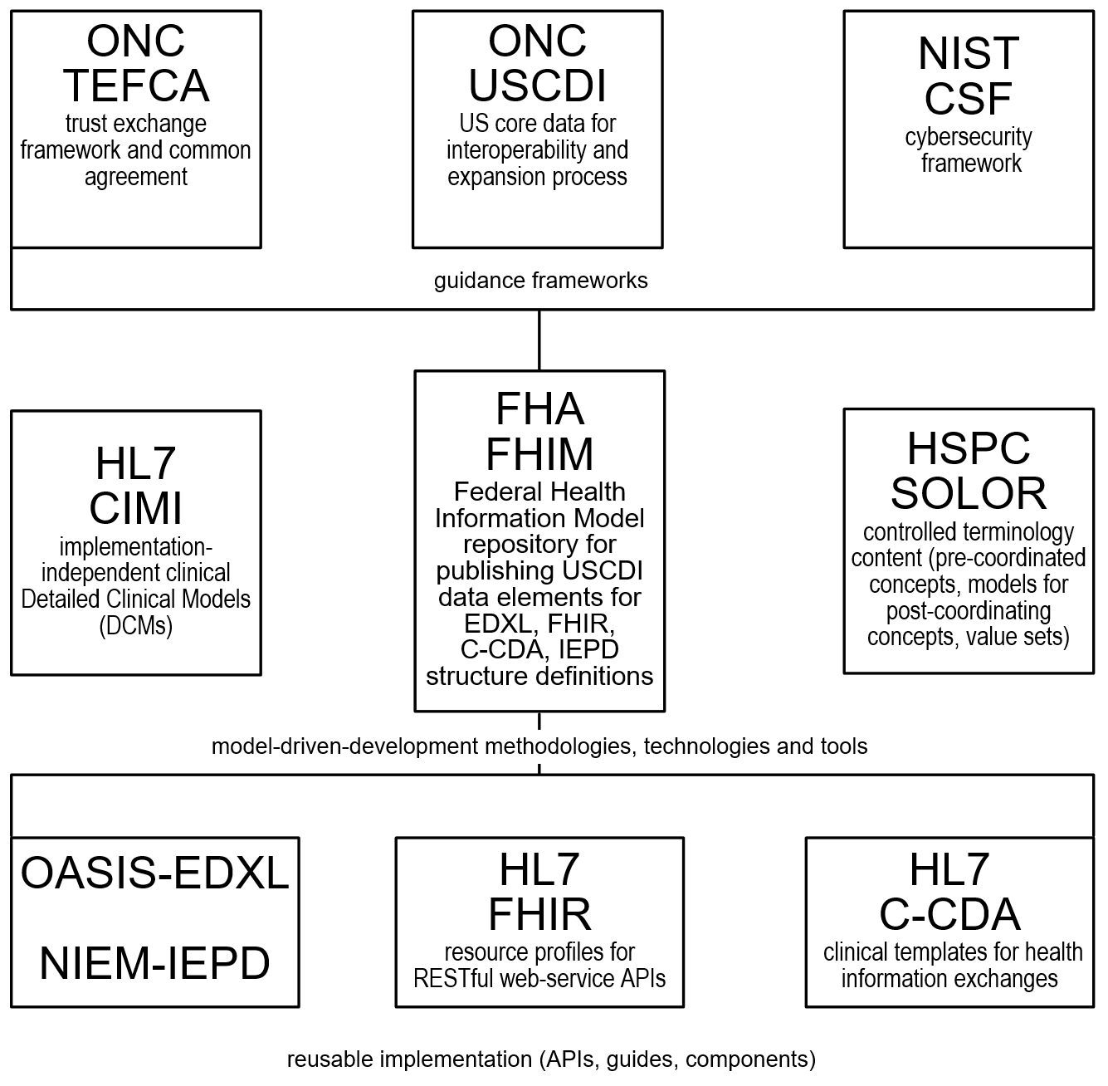
21st Century Cures Act Data-Quality Risk-Mitigation Landscape
Patient Value (safety, quality, cost) driver
ONC TEFCA and NIST CSF provide a secure trusted exchange and commom agreejment to support patient-centered relationships and care information sharing.
Value-based care includes population health
prevention/wellness
individual care based on population outcomes
innovative care delivery models
data-sharing, information analytics, knowledge
Policies, processes, and requirements evolve
Fully-qualified USCDI-FHIM-CIMI detailed clinical models (DCMs) are clear, complete, concise, correct and consistent logical requirements-specifications.
SOLOR models-of-meaning enable computable data-information sharing empowering population-analytics and decision-support reasoning.
Smart Healthcare IT and Mobile Apps are efficiently-and-effectively updated by an agile Model-Driven Development (MDD) methodology.
MDD produces quality operational EDXL, FHIR, C-CDA, IEPD APIs, components and test fixtures. .
Healthcare IT Risk-Management by Standardizing Data: TEFCA-USCDI-FHA-OASIS-HL7-NIEM-HSPC standards, policies, models, methodologies, technologies and model-driven-development tools for federated EDXL-FHIR-CDA-IEPD implementation APIs, guides and components.
See
Notes Pages
9
Notes:
Our IT objective is to make the appropriate data available when it is needed, where it needed and how it is needed. We plan to integrate existing models, with semantically-consistent computable-data, including provenance data (who, what, when, where, why, how) across different platforms, e.g., population health, Clinical Decision support, EHR patient documentation systems, etc. using tooling to generate various implementation styles, including HL7 Fast Healthcare Interoperable Resources (FHIR).
Patient Value (safety, quality, cost) driver
ONC TEFCA and NIST CSF provide a secure trusted exchange and commom agreejment to support patient-centered relationships and care information sharing.
Value-based care includes population health
prevention/wellness
individual care based on population outcomes
innovative care delivery models
data-sharing, information analytics, knowledge
Policies, processes, and requirements evolve
Fully-qualified USCDI-FHIM-CIMI detailed clinical models (DCMs) are clear, complete, concise, correct and consistent logical requirements-specifications.
SOLOR models-of-meaning enable computable data-information sharing empowering population-analytics and decision-support reasoning.
Smart Healthcare IT and Mobile Apps are efficiently-and-effectively updated by an agile Model-Driven Development (MDD) methodology.
MDD produces quality operational EDXL, FHIR, C-CDA, IEPD APIs, components and test-fixtures. .

Slide 10
Data-Quality Risk-Mitigation Strategy Model-Driven-Development Methodology
FHIM, using SMEs,
Standards,
US Regulatory Requirements
CQI, using SMEs,
CQF, vMR & QDM
Requirements
CIMI, using SMEs,
FHIM & CQI
Domain Models
CIMI Principles & Reference Models
CIMI Principles & Reference Models
CIMI Principles & Reference Models
FHIM
Domain Models
QI Quick & DAF
Domain Models
CIMI DCMs
CQI eCQMs
CDS KNARTs
US Core Data for Interoperability (USCDI)
SOLOR Terminology Editor
SNOMED CT, LOINC and RxNorm Semantics
VSAC Terminology Server
Manual or using Tools
Manual or using Tools
Manual or using Tools
Interoperability Specifications and Implementation Artifacts
EDXL, CDA, IEPD, FHIR (US Core, QI Core, Profiles, Extensions)
The benefit of standard USCDI-FHIM-CIMI Reference Data-and-Models for consistent Detailed Clinical Model (DCM) constrained-specifications for EDXL, FHIR, CDA and IEPD is an Architectural Framework for computable semantic-interoperability across time, locations, systems and care contexts. Seamless tools can result in efficient-and-effective federated mission-essential re-usable “stack” of standardized and widely implemented HSPC APIs, “SMART” components and test fixtures using SOLOR controlled terminologies.
collection, extraction-transformation-load, communication, aggregation and interpretation of patient data to accelerate secondary uses in public health, disease surveillance, metrics, and patient-centered outcomes research.
health-related services including telecare, clinical decision support, research, and quality measurement, improving healthcare access, quality, and uniformity.
Major patient, clinician, and public benefits from improved care coordination, reduction of medical errors, and decreased costs resulting in healthier lives.
Healthcare IT Risk-Management by Standardizing Data: TEFCA-USCDI-FHA-OASIS-HL7-NIEM-HSPC standards, policies, models, methodologies, technologies and model-driven-development tools for federated EDXL-FHIR-CDA-IEPD implementation APIs, guides and components.
See
Notes Pages
10
Notes:
The benefit of standard USCDI-FHIM-CIMI Principles and Reference Models resulting in Detailed Clinical Models (DCMs) for EDXL, FHIR, CDA and NIEM is an Architectural Framework for computable semantic-interoperability aka interpretability across time, locations, systems and care contexts, assuming the re-usable “stack” is standardized and has widespread implementation. Seamless tools can result in efficiency and effectiveness. This information-model “stack” foundation is mission-essential for
collection, communication, aggregation and interpretation of patient data to accelerate secondary uses in public health, disease surveillance, post-approval monitoring, and patient-centered outcomes research.
health-related services including telecare, clinical decision support, research, and quality measurement, improving healthcare access, quality, and uniformity.
patients, clinicians, and the public to realize major benefits from improved care coordination, reduction of medical errors, and decreased costs resulting in healthier lives.

Slide 11
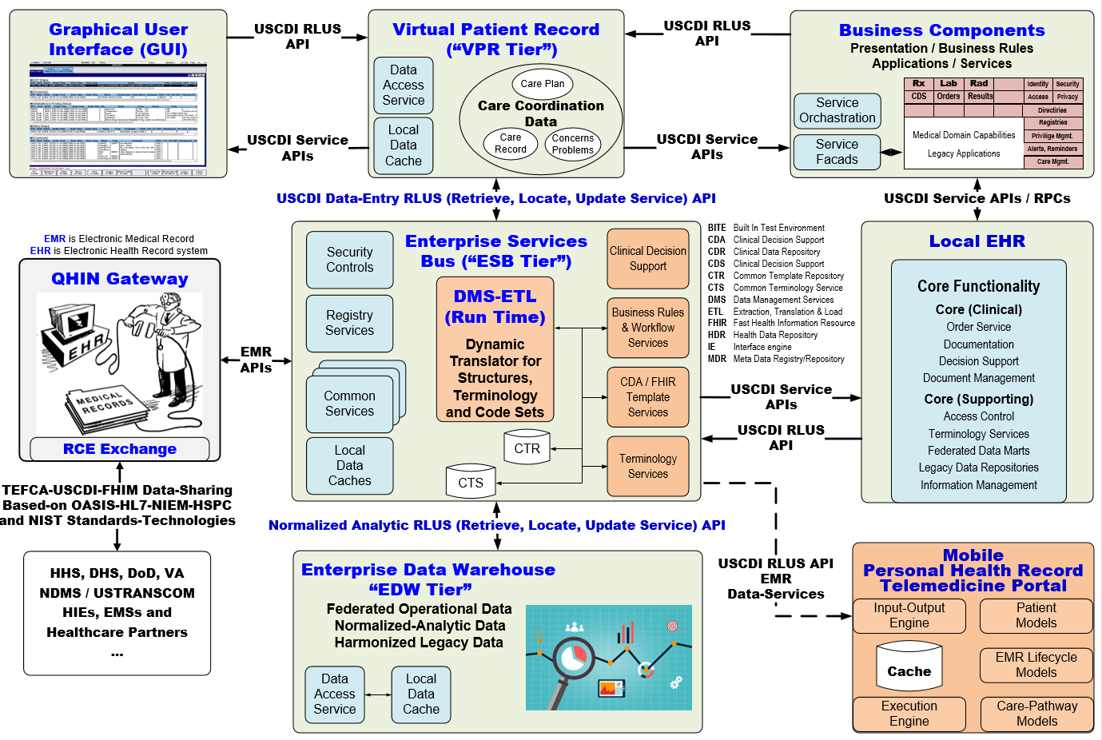
21st Century Cures Act Notional Future-State EHR-Modernization Architecture
Healthcare IT Risk-Management by Standardizing Data: TEFCA-USCDI-FHA-OASIS-HL7-NIEM-HSPC standards, policies, models, methodologies, technologies and model-driven-development tools for federated EDXL-FHIR-CDA-IEPD implementation APIs, guides and components.
See
Notes Pages
11
Notes:
Our IT objective is to make the appropriate data available when it is needed, where it needed and how it is needed. We plan to integrate existing models, with semantically-consistent computable-data, including provenance data (who, what, when, where, why, how) across different platforms, e.g., population health, Clinical Decision support, EHR patient documentation systems, etc. using tooling to generate various implementation styles, including HL7 Fast Healthcare Interoperable Resources (FHIR).

Slide 12
Emergency-Management Data-Quality Strategy Summary of new Requirements
Goal: Computable-interoperability among ad-hoc partners using heterogeneous systems
Consistent US Realm/Core structure specification and terminology value sets for
V2 messages, C-CDA templates, FHIR profiles and extensions
Information Exchange Package Documents (IEPDs)
Reference (Implementation Guides, APIs, implementation components)
“Dummies Guide” for clinical users, analysts, architects, engineers and implementers.
Objective 1: Bi-directional ETL mapping, without losing information, between
EHR data-entry, reporting and viewing pre-coordinated form to
EDW analytic-normalized post-coordinated form for population healthcare and CDS reasoning.
Objective 2: Governed and versioned SNOMED CT ETL extension for LOINC and RxNorm
using Model Driven Development (MDD) Tools, including
USCDI-FHIM harmonized domain-models, creating
Freely available context-specific Detailed Clinical Models / Clinical Statements
Context-specific pre-post coordinated form DCM templates bound to
Freely available terminology value sets
for HIEs, venders,
healthcare-partners
Healthcare IT Risk-Management by Standardizing Data: TEFCA-USCDI-FHA-OASIS-HL7-NIEM-HSPC standards, policies, models, methodologies, technologies and model-driven-development tools for federated EDXL-FHIR-CDA-IEPD implementation APIs, guides and components.
See
Notes Pages
12

Slide 13
Questions? Stephen.Hufnagel.HL7@gmail.com 703-575-7912
Benefit: Computable interoperability within Health Information Networks (HIN), Qualified HINs (QHINs) and Recognized Coordinating Entity (RCE) by standardizing pre-post coordinated terminology mappings and value sets within an FHA managed USCDI-FHIM-DCM US-realm SNOMED extension for LOINC and RxNorm can positively influence patient-value (safety, quality, cost), by empowering better analytics, reasoning and outcomes measurements.
Acknowledgement: This work would not be possible without
Thought leadership from Stan Huff, Keith Campbell, Nona Hall, Mark Kramer, Walter Sujanski, Rob McClure, Susan Matney, Jay Lyle, Claude Nanjo, Richard Esmond, Mark Kramer, Galen Mulrooney, Sean Muir, Gerard Freriks, and other HL7 and HSPC participants.
Mentoring, focus and encouragement from Nancy Orvis, Gail Kalbfleisch, Bob Bishop and Steve Wagner.
Thank You
Healthcare IT Risk-Management by Standardizing Data: TEFCA-USCDI-FHA-OASIS-HL7-NIEM-HSPC standards, policies, models, methodologies, technologies and model-driven-development tools for federated EDXL-FHIR-CDA-IEPD implementation APIs, guides and components.
See
Notes Pages
13

